Slide 1


Adventure Game
By Will, Andrew, Jack and Gregor

Slide 2
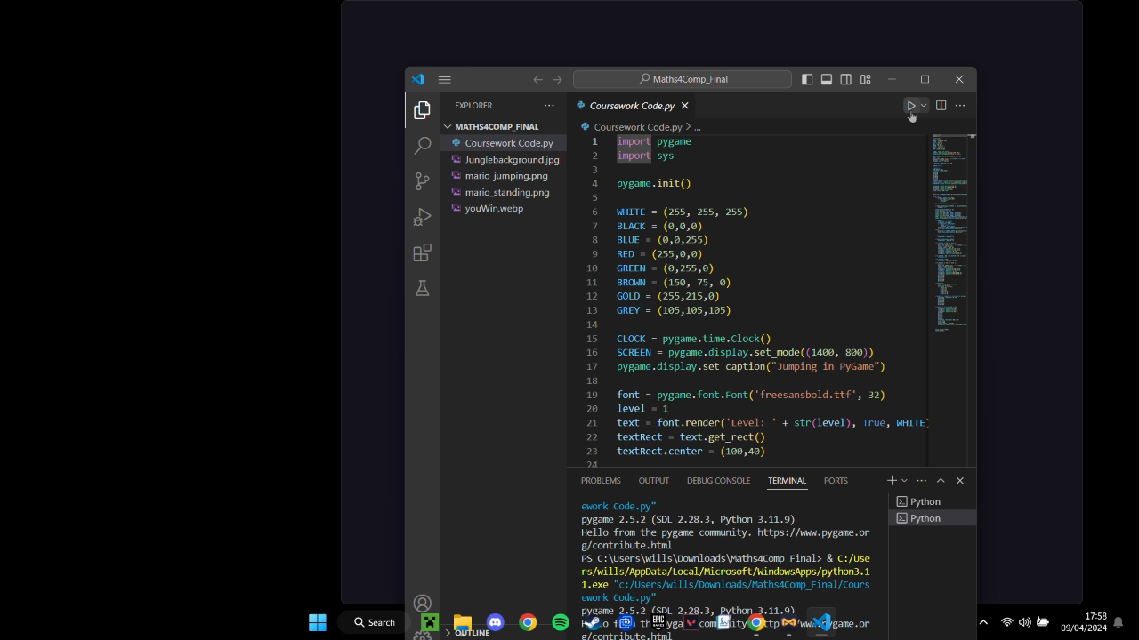
Demo Gameplay

Slide 3
Our Idea
Our Idea is an adventure and platforming game.
We have multiple levels with increasing difficulty.
The goal of the game is for the player to reach the end of each level while avoiding obstacles and traps.

Slide 4
Functionality
Functions For:
  Dart Projectile
  Level Progression
  Player Movement

Slide 5

Test Simulations
The Pitfalls
Dart Motion
Movement

Slide 6
Possible Additions
Buffs or Power ups
More Levels
Additional Traps or Obstacles

